Slide 1

Aspects of consciousness
4. Conscious recollection
Public domain image
Notes:
http://en.wikipedia.org/wiki/File:RobertFuddBewusstsein17Jh.png

Slide 2
Scientific study of consciousness
Consciousness
Perception
Attention
Memory
Action
Blindsight
Meditation
Episodic
Frontal patients
Normal awareness
Hallucinogens
Autonoetic
Drug addiction
Voluntary action
P- consciousness
A- consciousness

Slide 3
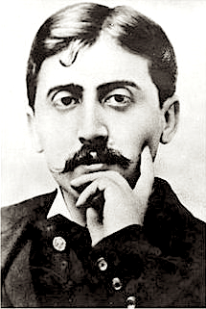
À la recherche du temps perdu
A literary example of the phenomenology of conscious recollection.
  Marcel Proust (1871-1922)
  “In search of lost time”, previously translated as “Remembrance of things past”.
What can psychology tell us about the mechanisms of conscious recollection?
Public domain image
Notes:
https://commons.wikimedia.org/wiki/File:Marcel_Proust_1900-2.jpg

Slide 4
Episodic memory
Proust is describing an episodic memory.
  A “what, where, when” memory.
What brain structure(s) are responsible for the encoding and retrieval of episodic memories?
Public domain image

Slide 5
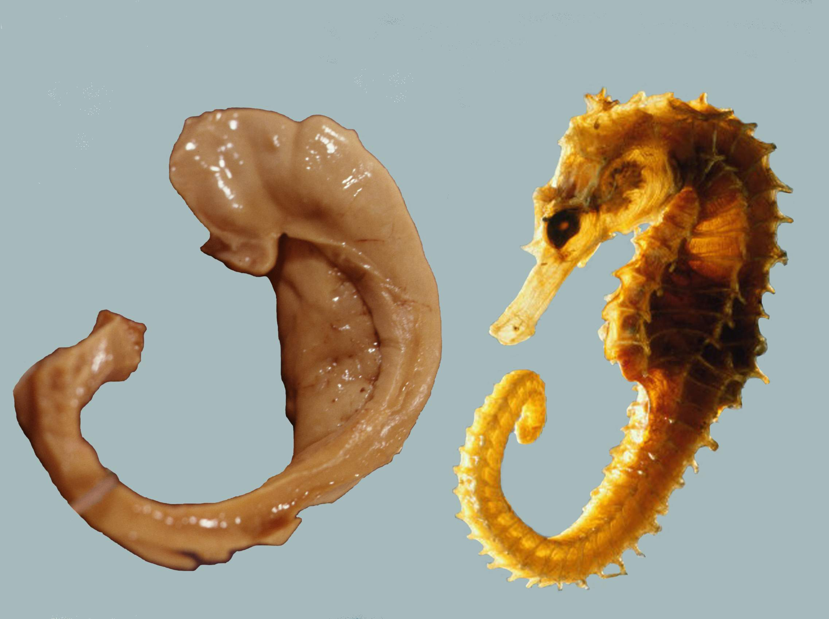
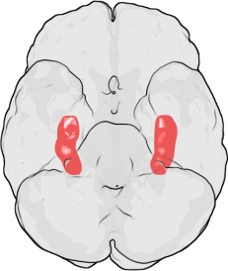
Hippocampus – “Sea horse”
Public domain image
Image credit: Laszlo Seress. CC BY-SA 1.0 Generic
Notes:
https://commons.wikimedia.org/wiki/File:Hippocampus.png
https://en.wikipedia.org/wiki/File:Hippocampus_and_seahorse.JPG

Slide 6
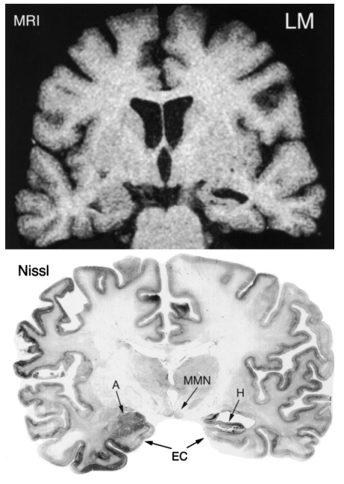
Hippocampal damage
Rempel-Clower et al. (1996)
  Three patients with brain damage limited to the hippocampus.
Image credit for this and the next 5 slides: Rempel-Clower et al. (1996). J. Neuroscience, 16, 5233. Creative Commons Attribution-Noncommercial-Share Alike 3.0 Unported
Notes:
www.jneurosci.org/site/misc/Permissions_Policy.pdf

Slide 7
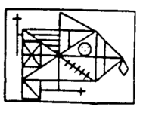
Memory impairments
Paired associates test
CUP – TREE
…
BRICK – ELEPHANT
(10 items)
Word recall
POTATO
…
BLACK
(15 items)
Diagram completion
  Copy, and then reproduce after 15 min delay.

Slide 8
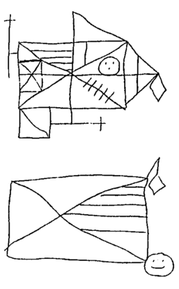
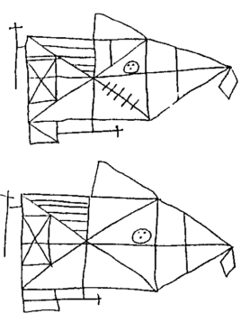
LM
CONTROL

Slide 9
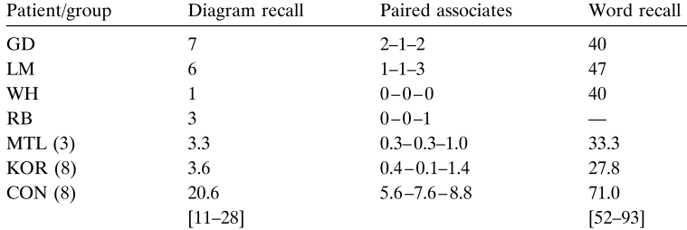
Anterograde memory impairments
The diagram recall score is based on delayed (10–15 min) reproduction of the Rey–Osterrieth figure (Osterrieth, 1944) (maximum score: 36). The paired associates score is the number of words recalled on three successive trials (maximum score: 10 / trial). The word recall score is the percentage of words recalled out of 15 across five successive study-test trials (Rey, 1964). [Rempel-Clower et al., 1985]

Slide 10
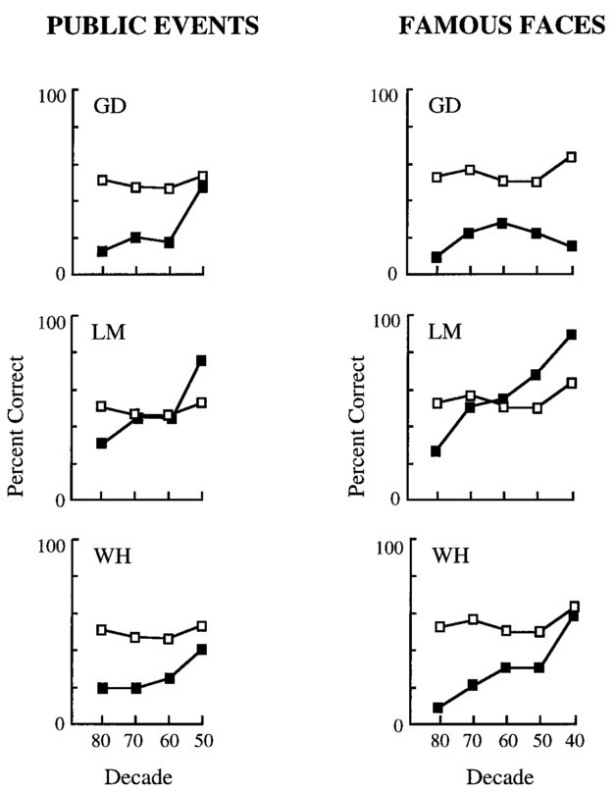
Retrograde impairments
Recall tests, by decade.
Open squares show control performance.

Slide 11
Specific impairment?
A bit of the brain is damaged (hippocampus), and memory is affected.
This is in the context of normal IQ (WAIS-R) scores.
So, interesting … but is this specifically an episodic memory impairment? Or just memory in general?

Slide 12
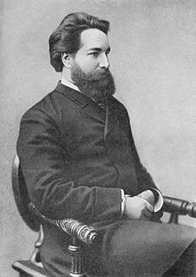
Korsakoff amnesia
Korsakoff syndrome is caused, most commonly, by vitamin B1 deficiency brought about by chronic alcoholism.
Recent work confirms that the amensic symptoms are due to hippocampal damage (Sullivan & Marsh, 2003).
Public domain image
Notes:
http://en.wikipedia.org/wiki/Sergei_Korsakoff

Slide 13
Cermak et al. (1985)
Korsakoff amnesic vs. alcoholic controls.
Recognition memory
Train: BOAT, … HEDGE (5 items)
Test (immediate or 1 min delay):
BOAT, … FRIDGE (10 items, 5 targets).
Priming
Present word for 35ms, record time to identify word.
Faster RT for presented words = memory for those words.
Summary: impaired recognition but preserved priming.
Recognition (% correct)
Imm Delay (1 min)
Kor 83% 68%
Alc 87% 79%
Priming (ms)
Imm Delay (1 min)
Kor 10 10
Alc 6 17

Slide 14
Cermak et al. (1985) … cont’d
As previous experiment, except using pseudo-words
  STIMP
Summary: Amnesiacs have impaired priming for pseudo-words (in fact n.s. priming in this study).
Recognition (delayed)
Kor 53%
Alc 86%
Priming (immediate)
Kor 18
Alc 55

Slide 15
Baddeley & Wilson
Errorful training
  I am thinking of a five-letter word beginning “QU”. Can you guess what it is?
  QUEEN?
  No, good guess, but the word is QUOTE.
Errorless training
  I am thinking of a five-letter word beginning “QU” and the word is QUOTE.
Amnesics (5 items) vs. Controls (10 items)

Slide 16
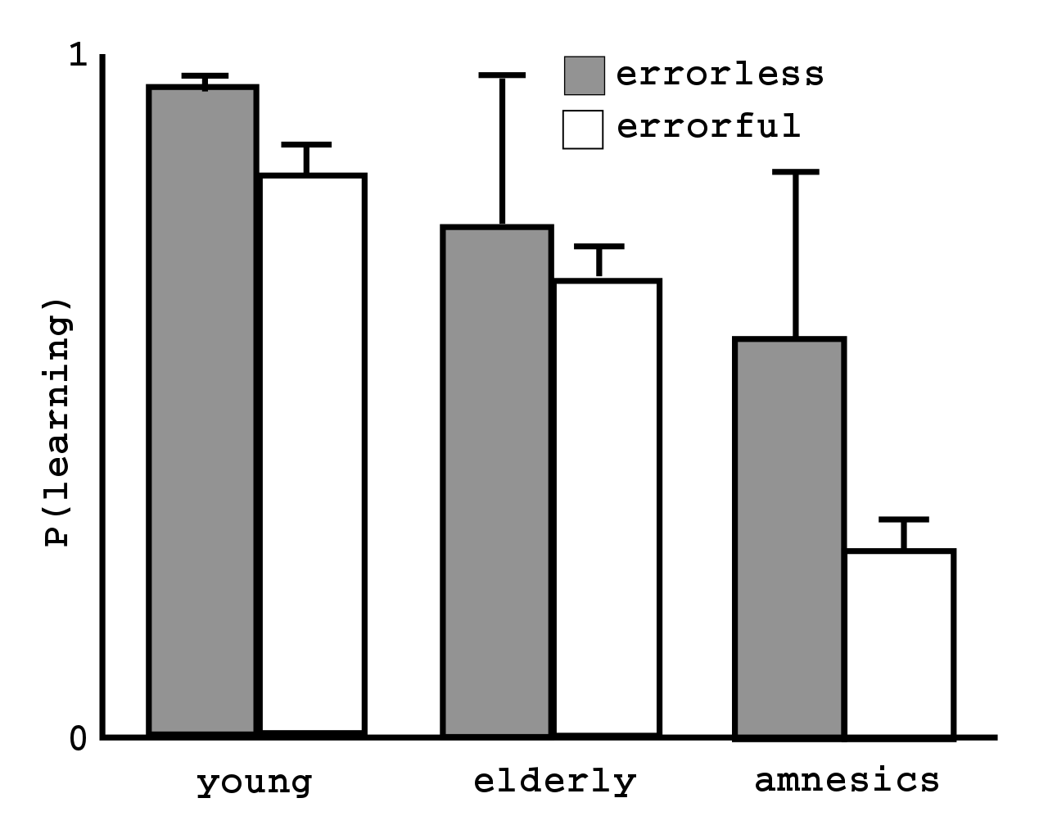
Baddeley & Wilson

Slide 17
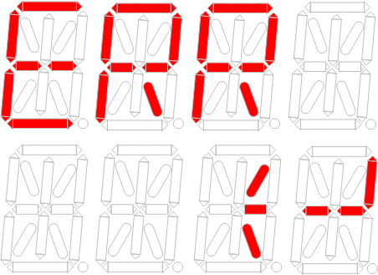
Baddeley & Wilson
Summary
  Amnesiacs find errorful training particularly difficult.
  The theory here is that they have particular difficulty distinguishing between memories of errors they have made with the memories of the correct answer.
  Again, then, evidence that amnesiacs may have relatively unimpaired familiarity-based memory, but problems in the appropriate use of more episodic information.
Image credit: Ameya arsekar. CC BY-SA 3.0 Unported.
Notes:
http://commons.wikimedia.org/wiki/File:Error.gif

Slide 18
Amnesia
Hippocampal damage
Memory deficit
Deficit seems particularly for episodic information.
So … hippocampus is the (a?) site of episodic memory and hence of Proustian conscious recollection?

Slide 19
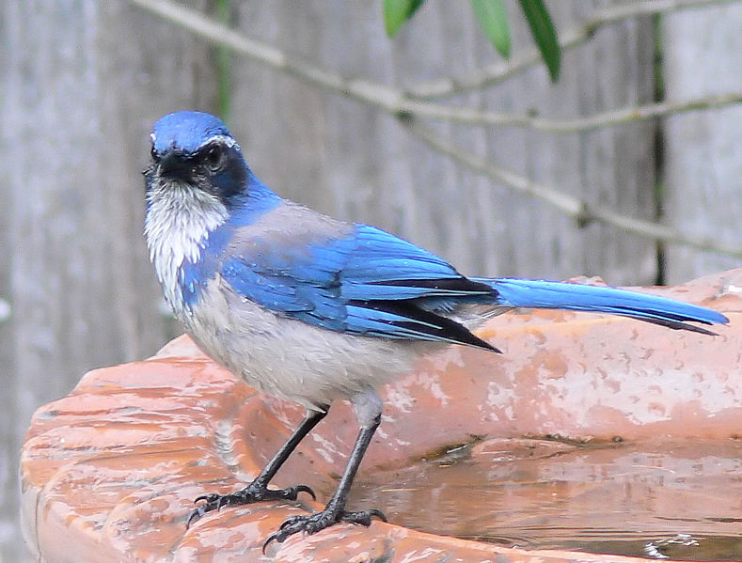
Scrub jays
Image credit: Jessica Merz. CC BY 2.0
Notes:
https://commons.wikimedia.org/wiki/File:Western_Scrub_Jay,_Novato,_California.jpg

Slide 20
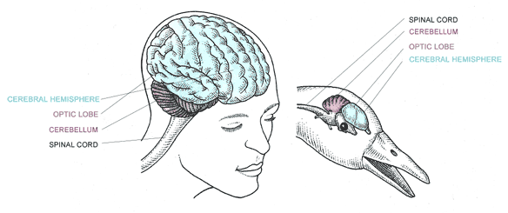
Bird brains
Uncredited anonymous image, assumed public domain.
Notes:
http://2.bp.blogspot.com/-5ViGJKsKfpQ/UH4seXatvDI/AAAAAAAAB4w/-T8oJG_3SQM/s1600/birdbr.gif

Slide 21
Scrub jay memories
Scrub jays cache 1000s of food items.
The scatter cache – distribute their caches over a wide area.
They successfully retrieve these caches after long delays.
Do scrub jays have episodic memories?
Could you do this ??
Alternative explanations:
  They are using smell / visual cues.
  They do remember what and where, but do not remember when (hence not episodic).
  Hard to test in the field; so let’s look in the lab…

Slide 22
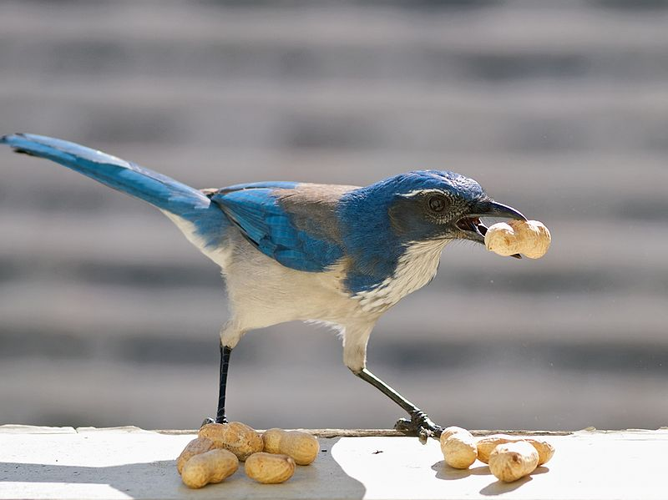
Clayton & Dickinson (1998)
Image credit: Ingrid Taylar CC BY 2.0
Notes:
https://commons.wikimedia.org/wiki/File:Western_Scrub_Jay.jpg

Slide 23
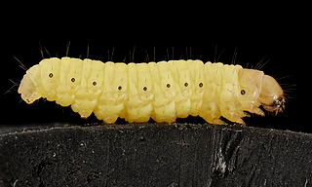
Clever tricks
Solving smell/visual cues
  In final tests, wash trays, refresh the sand in the trays, and remove the caches.
Solving “when”
  Scrub jays prefer waxworms to peanuts.
  But waxworms “go off” quite quickly.
  So, if they know when they stored the foods, then they should retrieve the waxworm after a short interval, but the peanut after a longer interval.
What if their memory for waxworms just decays more quickly?
  Use hand-reared birds, and train one group that waxworms do not go off (by replenishing the worms).
Public domain image
Notes:
https://commons.wikimedia.org/wiki/File:Wax_worm,_U,_Maryland,_side_2015-07-13-13.01.17_ZS_PMax.jpg

Slide 24
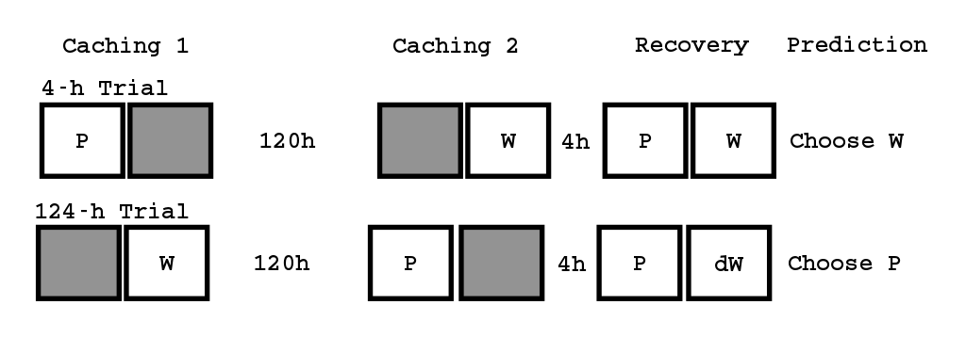
Lab procedure
Conditions and contents of the caching tray on different phases of 4-h and 124-h training and trials. The trial designation refers to the length of the time that elapsed between caching and recovering the wax worms. During the caching phases, birds were prevented from storing food items in the shaded halves of the tray by a cover, but they were free to cache in the open, non-shaded halves.

Slide 25
Results
As predicted
  Worms favoured after 4hrs but not 124 hours
  Only where jay knows worm decays over time.
Seems like the jay could only do this if it knew:
  What it cached,
  Where it cached it,
  When it cached it.

Slide 26
Interim summary
Storage and (sometimes) recall of episodic memories seems to critically involve the hippocampus.
And hippocampal damage seems to hit the “conscious” (flexible) use of memory.
But storage and recall of episodic memories is observed in very small-brained organisms.
Thus … is hippocampally-meditated episodic retrieval a good model of the kind of Proustian conscious recollection we started the session with?
My feeling is … no, it is not.

Slide 27
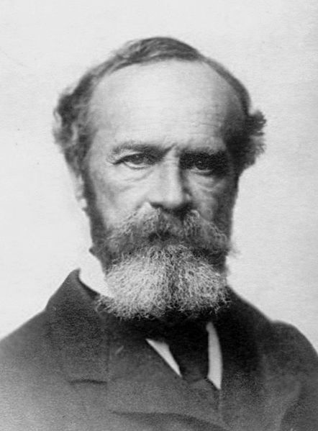
À la recherche du temps perdu
“Remembrance of things past”.
William James (brother of Henry James, and a founding figure of modern psychology):
“Remembrance is like a direct feeling; its object is suffused with a warmth and intimacy to which no object of mere conception ever attains”
In modern terminology, a useful phrase is autonoetic consciousness.
Public domain image
Public domain image
Notes:
https://commons.wikimedia.org/wiki/File:Wm_james.jpg

Slide 28
Autonoetic consciousness
Key reference:
  Wheeler, M. A., Stuss, D. T., & Tulving, E. (1997). Toward a theory of episodic memory: the frontal lobes and autonoetic consciousness. Psychological Bulletin, 121 , 331-54.
Summary
  Autonoetic consciousness is the distinctly human state of “mental time travel” – the examples provided by Proust and the definition suggested by James.
  The frontal lobes are a (the?) site of autonoetic consciousness.

Slide 29
Defining autonoetic consciousness
Noetic – knowing
Autonoetic – self-knowing
“Autonoetic consciousness is the capacity that allows adult humans to mentally represent and to become aware of their protracted existence across subjective time”.
As distinct from noetic consciousness...
“It is possible to be noetically aware of one’s self, including position in space ... And even autobiogrpahical facts that are not accompanied by a feeling of re-experiencing or reliving the past”.
Autonoetic consciousness concerns projection both forward and backwards in time – mental time travel.

Slide 30
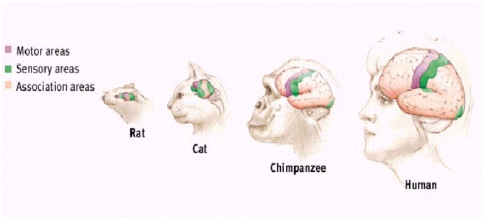
Why the frontal lobes?
Comparative arguments
  If we assume that autonoetic consciousness is a human-specific attribute, then perhaps makes sense to consider how the human brain differs most substantially from other brains.
    It’s frontal lobe enlargement
Anonymous image, assumed public domain.

Slide 31
Why the frontal lobes? Neuroimaging
Study a list of words
Episodic test (complete word stems using words from studied list)
Semantic test (complete word stems using first word that comes to mind; it was not possible to complete the stems from words in the studied list).
PET shows greater right frontal activity in the episodic than the semantic test.
Consistent across a range of labs and procedures (Nyberg et al., 1996, review).
Subsequent work indicates it is the attempt to retrieve, rather than its success or failure, that leads to right-PFC activity.
This implies a control, rather than a storage, function.

Slide 32
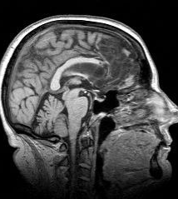
Frontal damage - Recall and recognition
  Frontal damage does not lead to full-blown amnesia
  But there are some free recall deficits, perhaps due to lack of application of strategic encoding (e.g. organization of material to aid later recall) and/or strategic retrieval (e.g. generate and recognise).
Anonymous image, assumed public domain.
Notes:
http://www.ucl.ac.uk/ion/departments/repair/themes/cognitive

Slide 33
Frontal damage – Source amnesia
Frontal damage can lead to profound source recollection deficits (i.e. much larger deficits than in standard recall tasks)
For example, ability to say accurately whether a particular fact was acquired during, or before, the experiment.

Slide 34
Developmental studies
Frontal lobes are late developing (significant neurogenesis until around Age 30, actually...).
What’s the relationship between age and autonoetic consciousness?
Place some items in a box, also tell children about some other contents of the box.
3 and 4 year olds show excellent retention of box contents
But only 4 year olds have good recollection of the source (ie. placed vs. told).
Young children have source amensia? (Other studies place this even later – say to around Age 6).

Slide 35
Query
Is source in such studies qualitatively different to when in the scrub jay studies?
  On the one hand, source is not task-relevant whilst when is.
  On the other hand, at least some studies confound source with when.

Slide 36
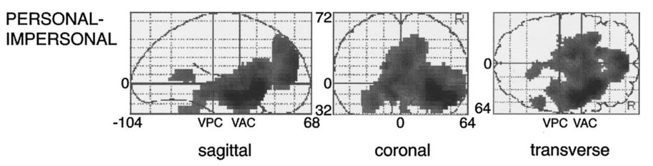
Personal relevance
Image credit: Fink et al. (1996). J. Neuroscience, 16, 4275. Creative Commons Attribution-Noncommercial-Share Alike 3.0 Unported
Fink et al. (1996)
  All the (human) work so far involves memories that, whilst episodic in nature are not autobiographical.
  In a neat study, Fink compared PET activation to presentations of description of events from someone else’s life, to presentation of events from your own life.
  These truly autobiographical memories seem to activate a broad network, including the frontal lobes.
  Perhaps this is one promising way of studying Proust / James remembrance?

Slide 37
Summary
Remembrance, in a Proustian sense, is a defining property of the concept of autonoetic consciousness.
In order for autonoetic consciousness to function, one must presumably have a functioning episodic encoding and retrieval mechanism (a necessary condition).
In humans at least, the hippocampus is one key mechanism.
The case of good episodic memory in scrub jays challenges (for many) the idea that having an episodic system is sufficient for remembrance.
Possibly, one also requires a functioning frontal memory system.
This system seems to serve a control/strategic/flexibility function in episodic memory retrieval (frontal free recall deficits; source memory deficits in fontal patients and children; PET studies).
It also seems particularly involved in autobiographical memory, as compared to similar information from other peoples’ lives.
Perhaps it is the involvement of this frontal control system that gives remembrance it’s particular vivid character?

